Slide 1
Letter Recognition
Vishweshwar Satpute
Batch: Nov 19

Slide 2
Objective
Problem Statement
Applying Machine Learning Algorithm to identify the uppercase alphabets.

Slide 3
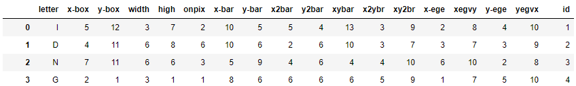
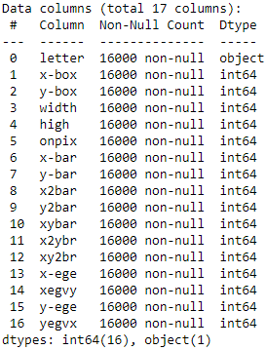
From the above columns we can remove/drop the id column as it do not help in order to find the target variable. Hence drop the id column
Analysis the data can find no duplicate value in the Data set .
There are 16 integer value and one object variable which is Letter column.

Slide 4
After Processing the Data
Number of instances: 16,000
Number of attributes: 17 (letter category and 16 numeric features)
Attribute characteristics: Integer
Associated Tasks: Classification
Missing Attribute Values: None
No Duplicate values found.
Dropped id column

Slide 5
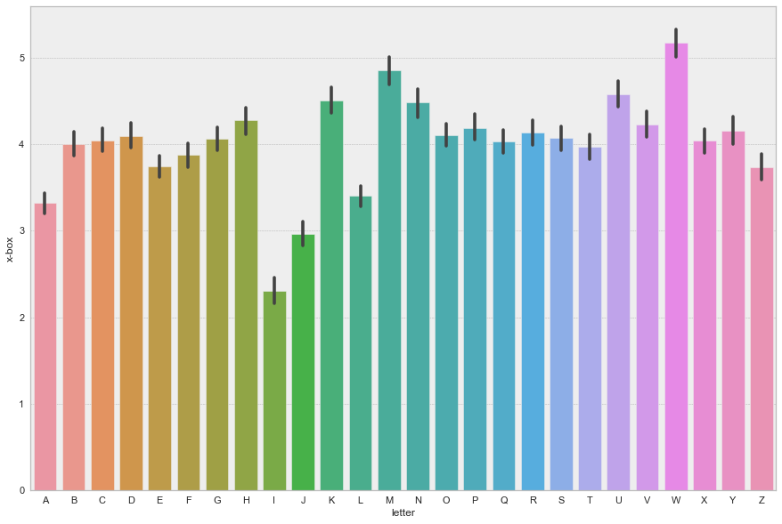
Frequency of letters

Slide 6
Splitting the Data
Splitting the data into X , Y considering Training 80% & Testing 20% for each respectively.
Shape of x Training Data is (12800, 16)
Shape of x Test Data is (3200, 16)
Shape of y Training Data is (12800,)
Shape of y Test Data is (3200,)

Slide 7
Support Vector Machine (SVM)
linear model
Accuracy: 0.86
non-linear model
Accuracy: 0.92
The accuracy achieved using a non-linear kernel (0.92) is mush higher than that of a linear one (0.86). We can conclude that the problem is highly non-linear in nature.

Slide 8
Decision
Tree
Random
Forest
KNN
Accuracy: 0.95
Accuracy: 0.94
Accuracy: 0.86

Slide 9
Conclusion
Applied different algorithm on the data to test the accuracy of the respective model.
Looking at the output of the different model, Random Forest performed better when compared to the SVM, Decision Tree & KNN.

Slide 10
Thank You

